Slide 1



Final Thesis Presentation
Automated Plant Disease Detection System
Internship Presentation
Information Technology
Payment Verification System
By : Bruh Tesheme Hailom Asegede
Tadesse G/mikael Kalayu Redae
Tekleab Gebremdhin
By: Tadesse Gebremikael
Bruh Tesheme

Slide 2

OVERVIEW
01
Introduction
07
Methodology
02
Problem Statement
08
System Development
03
Objectives
09
Results
04
Significance of Study
10
Drawbacks & recommendations
05
Literature Review
11
Future work
06
Proposed System
12
Conclusion

Slide 3


Introduction
damage
Background
Plant diseases are one of the most serious threats to crop production, causing major economic losses and threatening food availability. Because of detecting plant diseases are:
Largely manual,
Time-consuming, and
Inaccurate
Localization language

Slide 4

Cont’d..
This research proposes an Automated Plant Health Monitoring System that uses Convolutional Neural Networks (CNNs) for early and precise detection of plant diseases.
This research targets on apple, potato, and corn—supporting the country's food security efforts.

Slide 5
Problem Statement
Lack of Diagnostic Tools.
Limited Access to Expert Recommendations.
Many farmers lack affordable, easy-to-use tools in their own language to identify and manage plant diseases.
Major Threat to Agricultural Productivity

Slide 6


Objective
Main Objective
Develop an Automated Plant Health Monitoring System that uses Convolutional Neural Networks (CNNs) to detect and diagnose plant diseases in Tigray, Ethiopia.

Slide 7
Specific Objective
To provide Real-Time Insights.
Accurate Disease Recognition.
Easy and User-Friendly Interface.

Slide 8
Significance of the Study
Enhanced Food Security
Support for Indigenous Crops
Improved Farmer Livelihoods
Accessible, User-Friendly Solutions
Reduction in Misdiagnosis and Unnecessary Treatments
Foundation for Future Agricultural Innovations

Slide 9

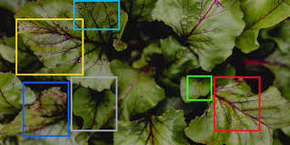
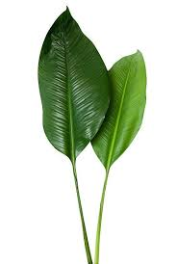
Proposed System
This research based project addresses disease detection across four plant species with localized variations, incorporating real-world environmental factors like lighting and weather conditions.

Slide 10

Cont’d..
Multi-Plant Disease Detection: Diverse Conditions and local datasets.
Integration with a Mobile Application.
Django Backend for Centralized Model serving.
Enhanced Usability.
.

Slide 11
Literature Review
1) Deep Convolutional Neural Networks for Plant Disease Detection by Mohanty
2. Transfer Learning for Automated Plant Disease Detection by Too el tal
3) Plant Disease Classification Using VGG and ResNet with Real-World Images by Sladojevic

Slide 12
Literature Review cont…
4.Real-Time Plant Disease Detection on Mobile Devices by Atila et al
5. Automated Detection of Potato Diseases Using CNNs by Kamilaris et al
6. Transformer-based Cactus Disease Detection by ViT Model

Slide 13
Literature Review cont…
Identified Drawbacks From Previous Studies
Generalization to Real-World Environments.
(Mohanty et al. and Kamilaris et al)
Dataset limitations (Too et al)
Computational Efficiency for Mobile Deployment (Atila et al.)
Specific Focus on Potato Disease Variability ( Kamilaris et al)

Slide 14
Literature Review cont…
Proposed Improvements Over Existing Studies
Multi-Plant Disease Detection with Diverse Conditions and local datasets.
Integration with a Mobile Application for Real-Time Detection.
Django Backend for Centralized Model serving

Slide 15
Methodology
1) Dataset Collection and Preparation
The dataset used in this project consisted of images of both healthy and diseased plants, gathered from:
Adigrat University Beles Institution.
Mekelle University, Agriculture Dep’t.
Kaggle dataset, publicly available sources

Slide 16
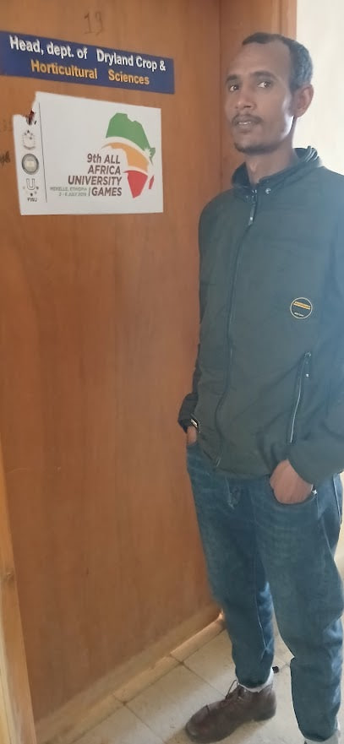
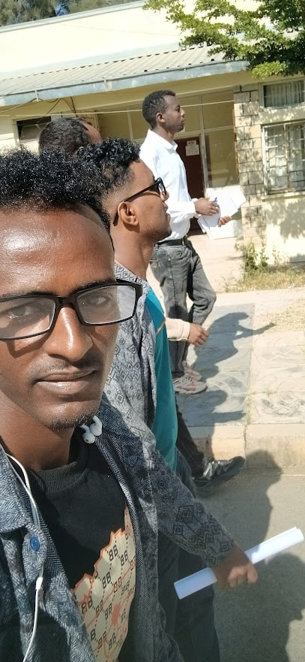
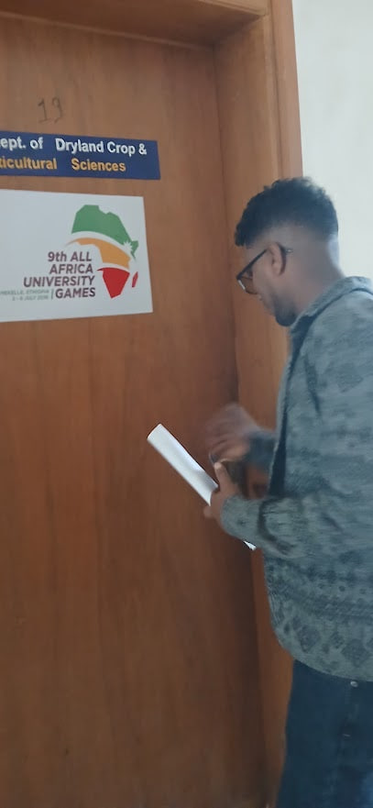
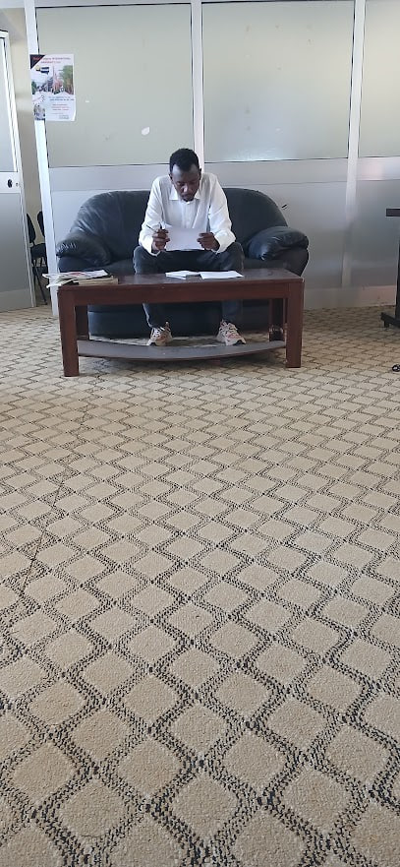

Slide 17
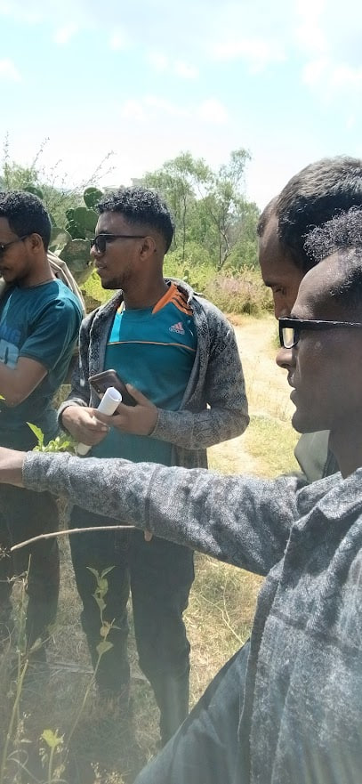
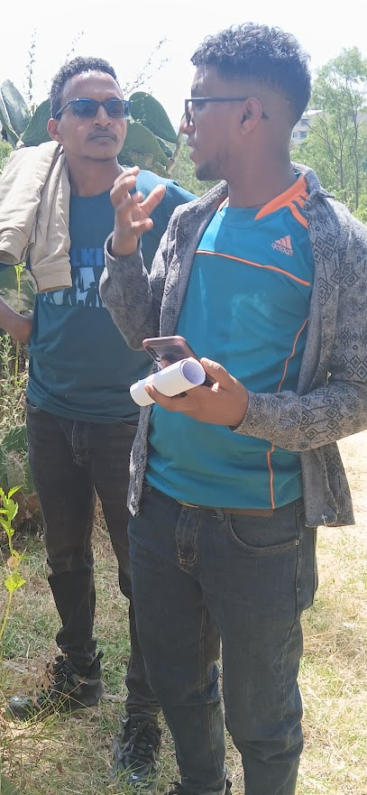
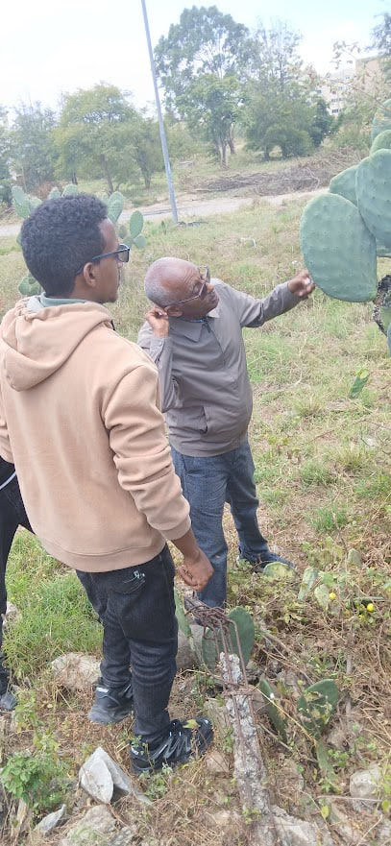
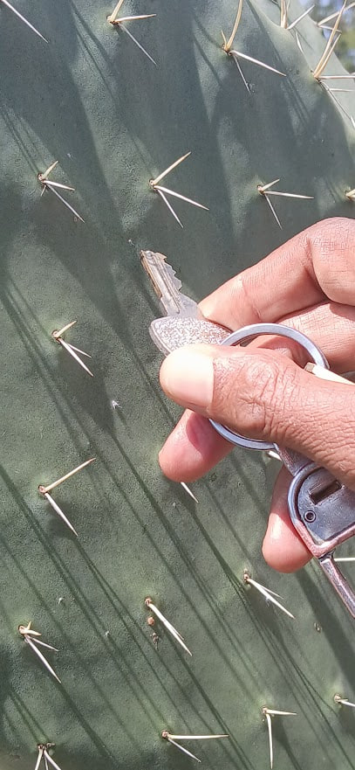

Slide 18
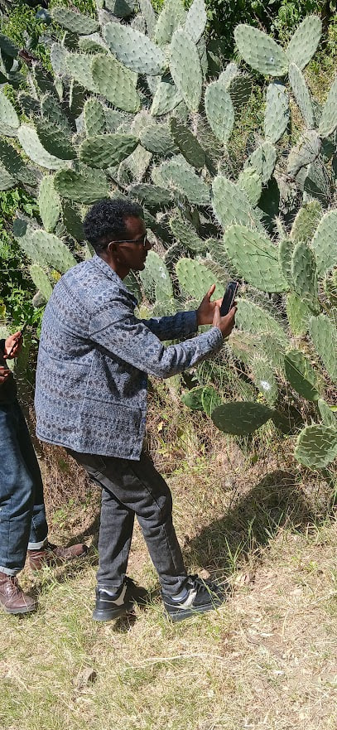
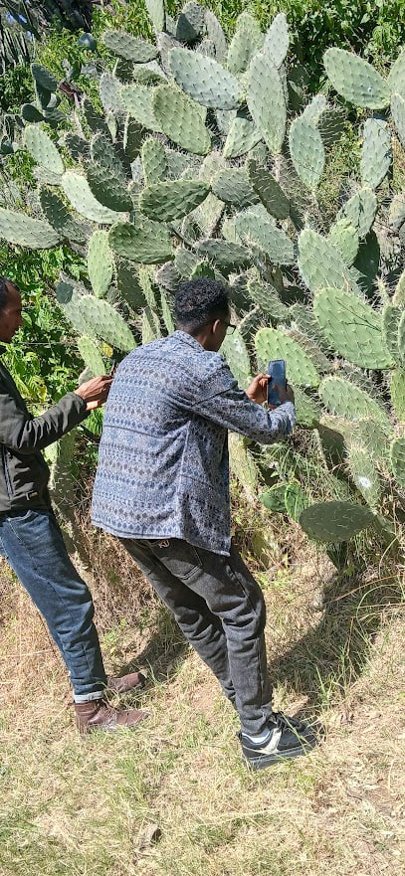
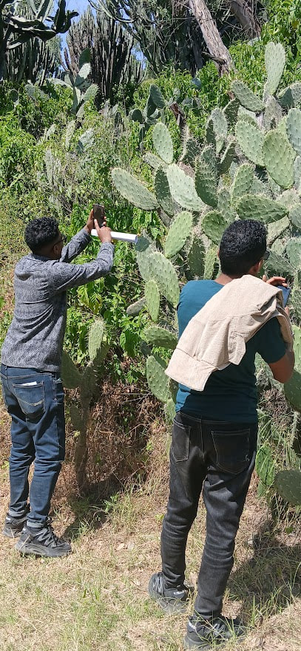
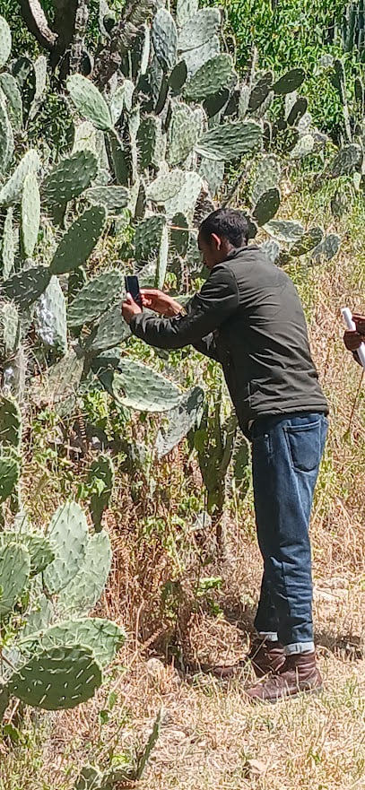

Slide 19
Cont’d..
i) Data Augmentation
ii) Data labeling and data splitting
iii) Image Acquisition and Preprocessing

Slide 20
iii) Image Acquisition and Preprocessing
Checked for quality and resolution standards
Compression: Reduces image file size
Resizing: Scales images to a uniform size
Normalization: Adjusts pixel values to a [0, 1] range
Color Conversion: convert from RGB to grayscale

Slide 21


2) Model Training and Disease Classification
The core model, a Convolutional Neural Network (CNN), was trained on the preprocessed and segmented dataset using Tensor Flow.
i) Model Architecture
ii) Training and Validation

Slide 22
Model Architecture
Convolutional Layers: Extract essential visual features
Pooling Layers: Perform dimensionality reduction
Hidden layer: A hidden layer, learns complex representations inputs.
Fully Connected Layers: disease classification based on the identified features.
Training and Validation - The model was trained and validated on a subset of the dataset.

Slide 23

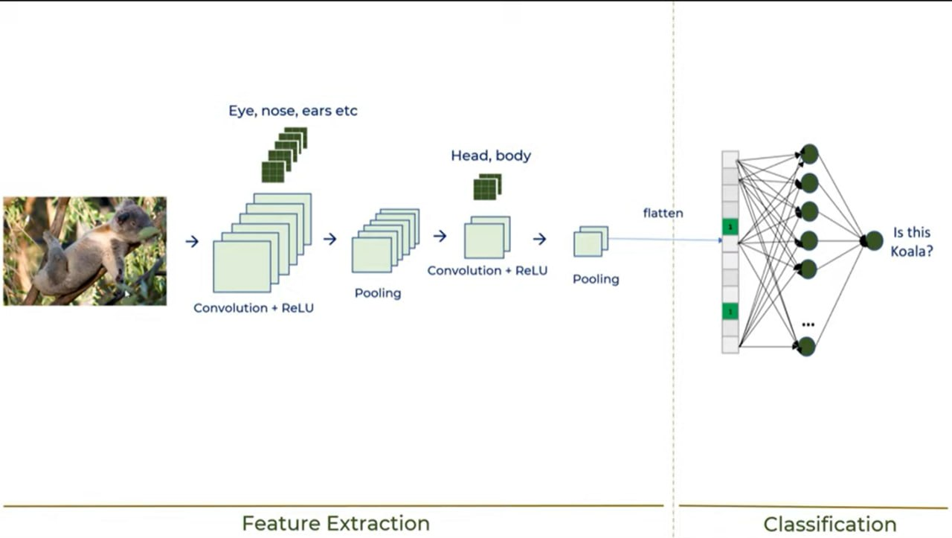

Cont’d..
Figure 1: Duplication of CNN Layers

Slide 24
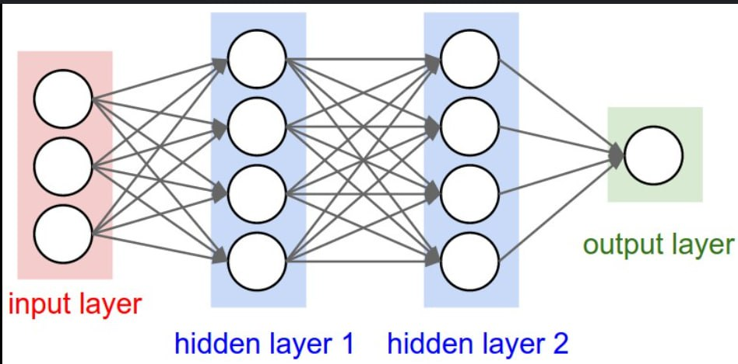
Cont’d..
Figure 2: CNN layers

Slide 25
3) Model Optimization
Model Optimization using Adam optimizer
The Adam optimizer adapts learning rates for each parameter by maintaining moving averages of gradients and squared gradients, improving convergence speed.

Slide 26
System Dev’t Methodology
We are conducting iterative reviews and seeking feedback from stakeholders in accordance with Agile practices, as we are not currently working directly with users.

Slide 27
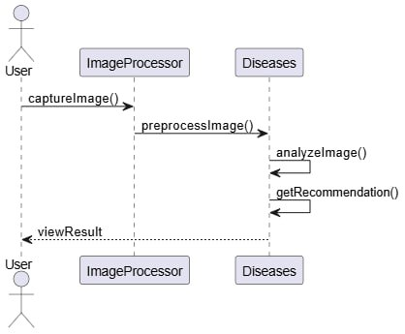
System Design

Slide 28
System Architecture and System Development
Model: CNN
Back - end: Django
Front- end: Flutter

Slide 29

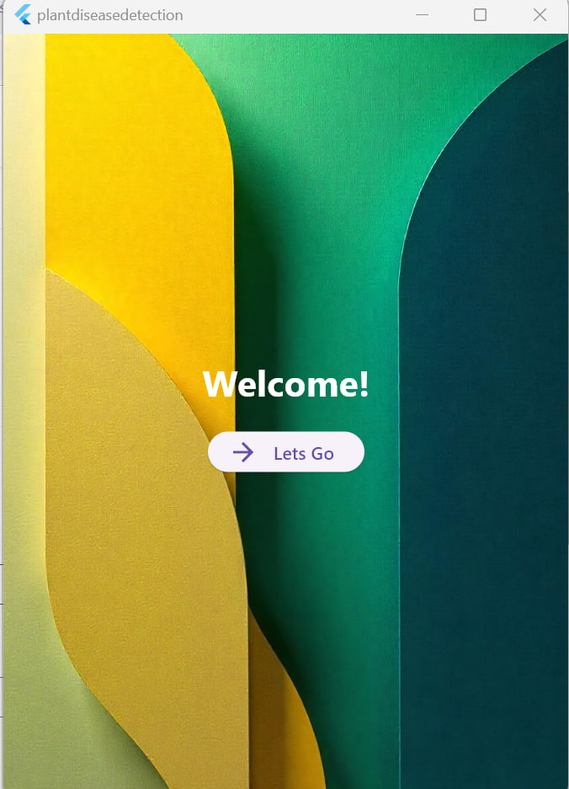
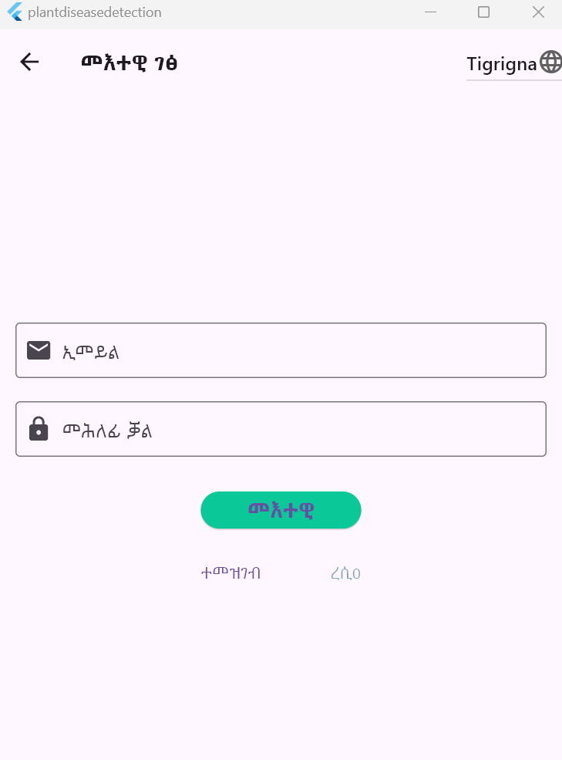
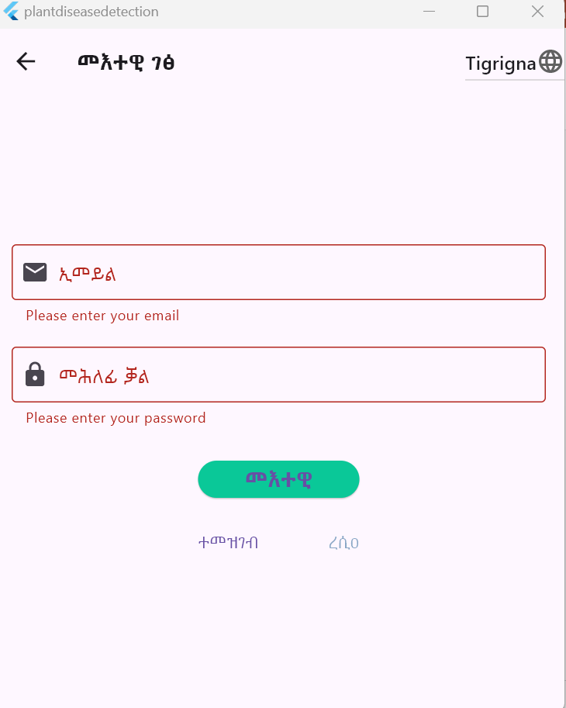
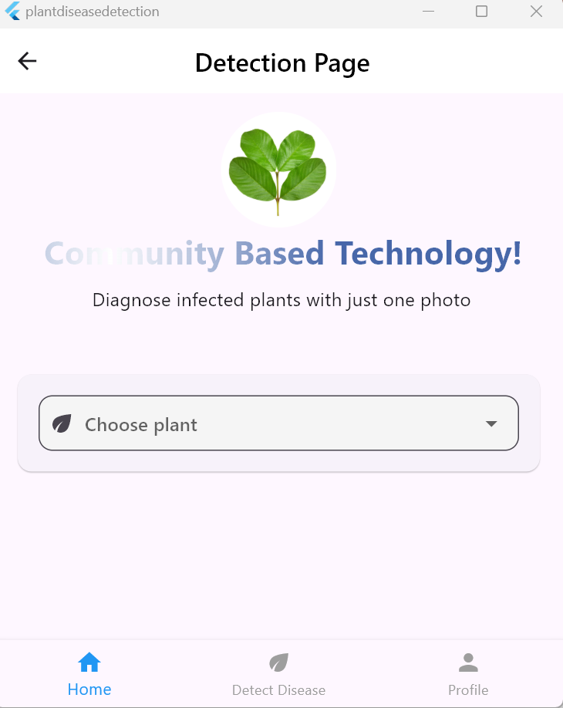
Results (Demo)

Slide 30
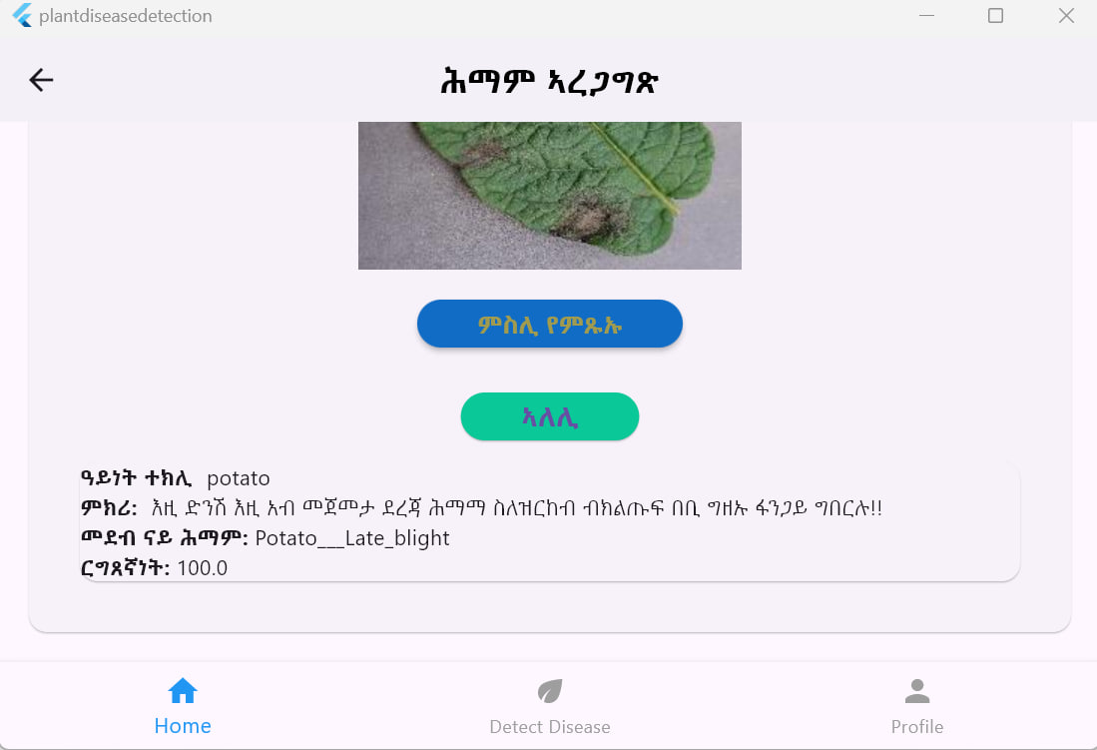
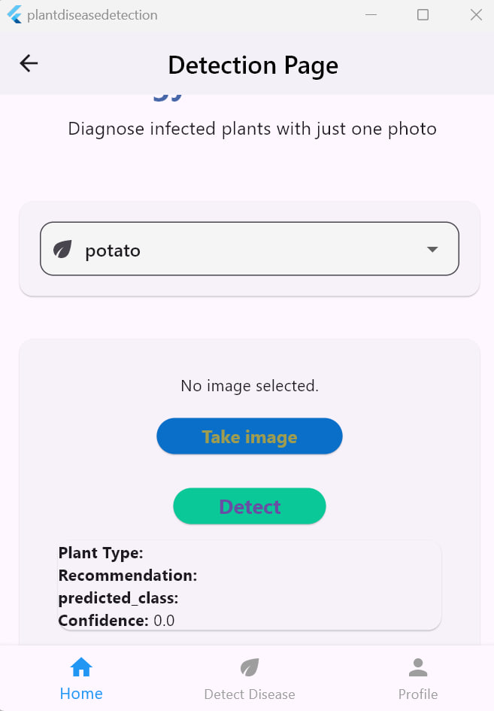
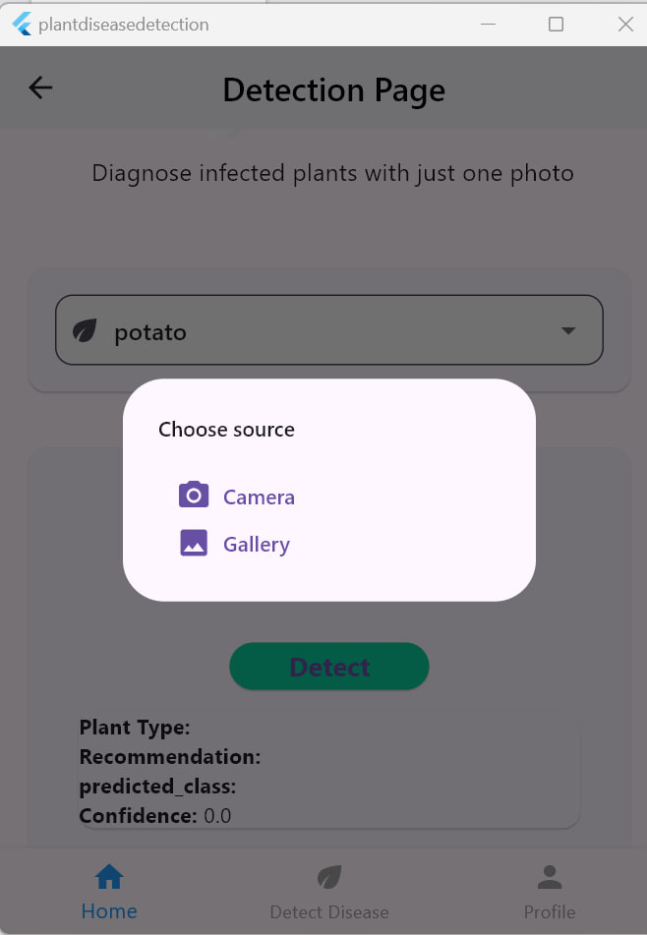
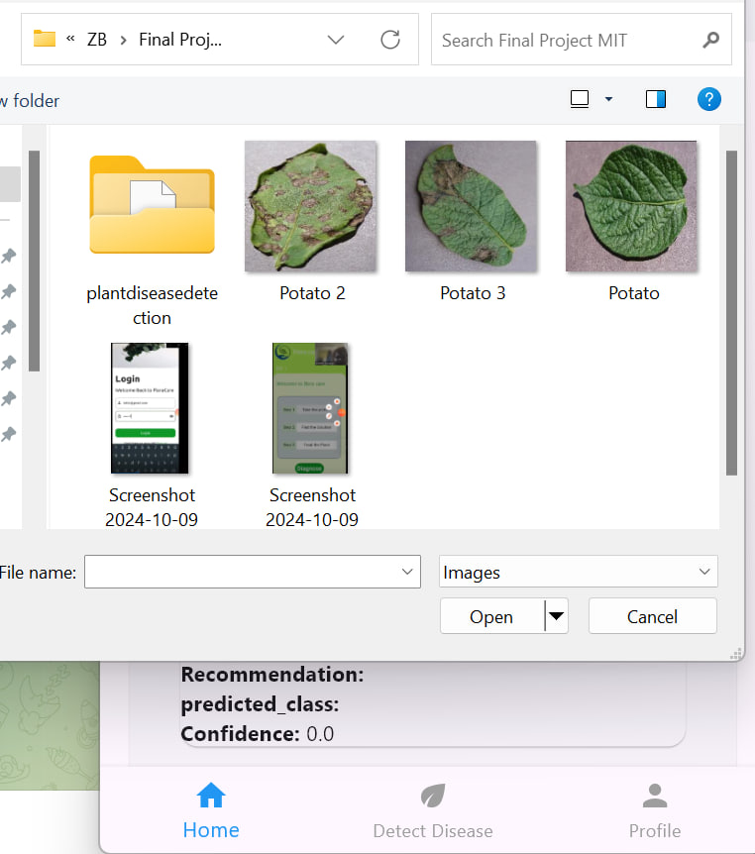
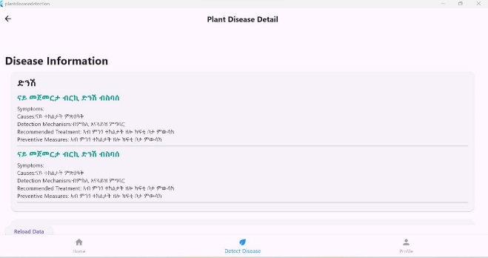
Results (Demo)

Slide 31
Challenges and Limitations
Dataset Limitations
Technological and Accessibility Challenges
Model Performance and Accuracy Challenges
Time and Resource Constraints
Processor capacity limitation.

Slide 32
Future Work
Expanding the Disease and Pest Database
Enhancing the system actors with their roles
Enhancing Model Performance Using Advanced Techniques
Integrating User Feedback
Enhance Mobile app in easy user friendly
Enabling Offline Functionality for Remote Area

Slide 33
Conclusion
The Automated plant disease detection system in Tigray achieves over 95% accuracy for most of the plants considered, aiding farmers in reducing crop losses and promoting sustainability. Despite its user-friendly design, it faces limitations like limited disease coverage and internet reliance. Future upgrades will expand the database, integrate IoT sensors, and provide offline access, aiming to enhance food security in the region.

Slide 34

Any Question ?

Slide 35
Thank You !!

